Slide 1
EIN 5226 Lecture: Exam Review 1
Topic: Hypothesis Testing

Slide 2

Hypothesis Tests
Single sample Mean, large sample size - Z test
Single sample mean, small sample size – t test
2 sample means, large sample sizes – Z
2 means, small sample sizes, variance equal – t
2 means, small sample sizes, variance unequal – t
Paired comparison – t
2 variances – F
Single sample proportion, Z test
2 proportions - Z
Proportions – chi squared test
Contingency Tables – chi squared test
Alpha and Beta errors, Power, determining sample size

Slide 3
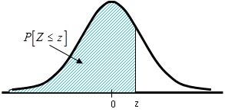
Standard normal distribution
µ= 0 and σ = 1
The standardized normal random variable, Z, is the number of standard deviations away from the mean, of a specified value, x.

Slide 4
The Central Limit Theorem
If a random sample of size n is drawn from a population with mean μ and variance, ,
then the sample mean, , has approximately a normal distribution
with mean μ and variance .
That is, the distribution function of is approximately a standard normal.
The approximation improves as the sample size increases.
Distribution of Sample means
where n=sample size
Distribution of Population
Std.Dev = σ
μ

Slide 5
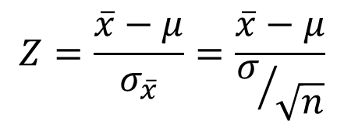
The Central Limit Theorem
If a random sample of size n is drawn from a population with mean μ and variance, ,
then the sample mean, , has approximately a normal distribution
with mean μ and variance .
That is, the distribution function of is approximately a standard normal.
The approximation improves as the sample size increases.
Distribution of Sample means
where n=sample size
$$Z=\frac{\overline{x}−μ}{σ_{\overline{x}}}=\frac{\overline{x}−μ}{σ/{\sqrt{n}}}$$
Distribution of Population
Std.Dev = σ
μ

Slide 6
Confidence intervals
A confidence interval is a range of values within which repeated sample statistics are predicted to fall a certain percentage of the time.
= risk that true population parameter will fail to fall in defined interval
Confidence level = 100 (1-α)%
Example: Risk 𝜶 = .05 or 5%
Confidence Level= .95 or 95%

Slide 7
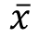
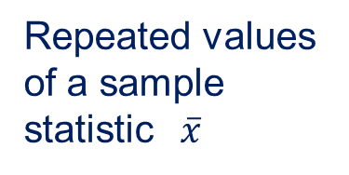
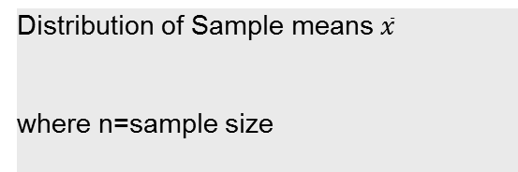
The Central Limit Theorem
Distribution of Sample means $\overline{x}$
where n=sample size
Repeated values of a sample statistic $\overline{x}$
Percentage of time
(area under curve)
Distribution of Population x’s
Std.Dev = σ
μ
Range of Values

Slide 8
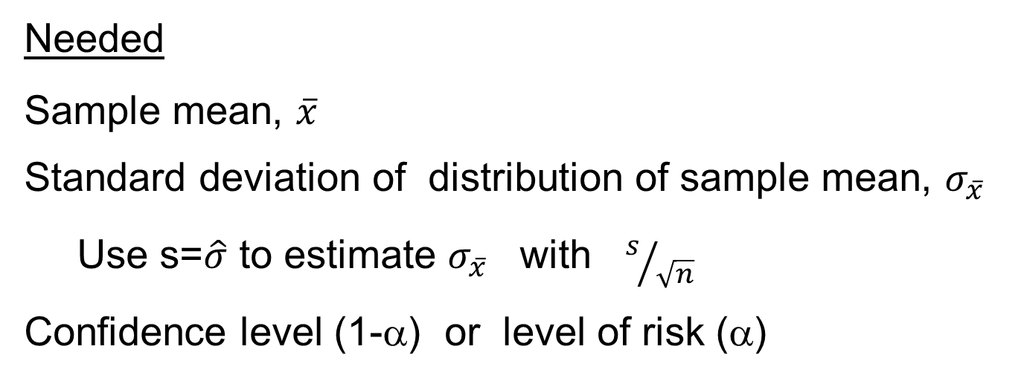
Large Sample (n≥30) Confidence Interval for Means
Needed
Sample mean, $\overline{x}$
Standard deviation of distribution of sample mean, $σ_{\overline{x}}$
Use s=$\hat{σ}$ to estimate $σ_{\overline{x}}$ with $s/{\sqrt{n}}$
Confidence level (1-α) or level of risk (α)
Confidence interval formulas:
Lower Limit Upper limit

Slide 9
Tests on Single Population Means Large Sample Sizes (n≥30)
 | Two-tailed | One-tailed
Null hypothesis H₀ | μ=μ₀
Alternate H_{a} | μ≠μ₀ | μ>μ₀ | μ<μ₀
Test statistic
p (reject if p<𝜶 ) | sum the areas in the tails, cut off by Z_{test} and –Z_{test} | Area to right of Z_{test} | Area to left of Z_{test}

Slide 10
Statistical Inference - Using p values
Steps in Hypothesis Testing
Identify your objective
State the null hypothesis, H₀
State the alternative hypotheses, H_{a}.
Calculate the appropriate test statistic
Compute the p value of the test statistic
Determine the acceptable risk
Compare the p value of test statistic to the to the acceptable risk.

Slide 11
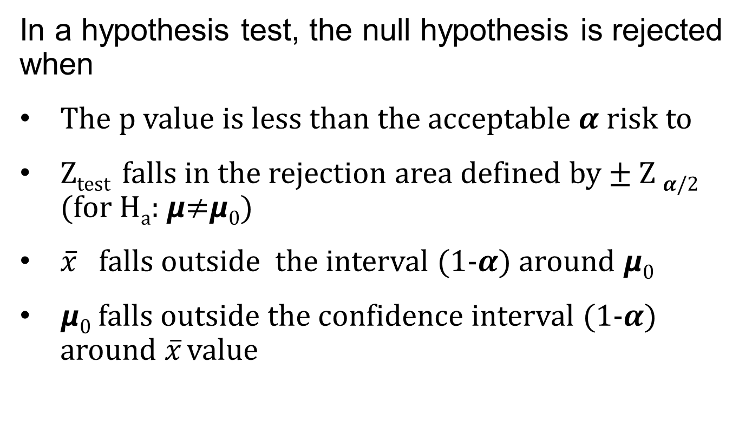
Rejecting the Null Hypothesis
In a hypothesis test, the null hypothesis is rejected when
The p value is less than the acceptable 𝜶 risk to
Z_{test} falls in the rejection area defined by ± Z _{𝜶/2} (for H_{a}: 𝞵≠𝞵₀)
$\overline{x}$ falls outside the interval (1-𝜶) around 𝞵₀
𝞵₀ falls outside the confidence interval (1-𝜶) around $\overline{x}$ value

Slide 12
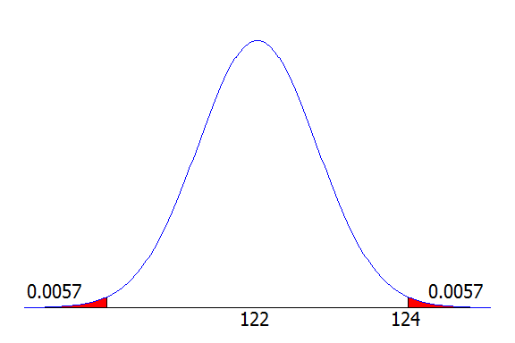
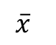
Calculating the P Value
Probability of value further out either side:
.0057+ .0057 = .0114 = p
Compare p to allowed 𝜶
If lower, is outside of the interval.
$$\overline{x}$$
𝞵₀

Slide 13
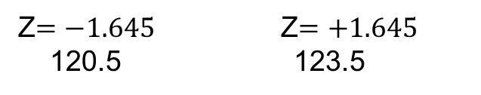
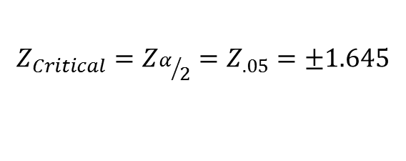
Compare Z_{test}
to Z_{critical} defined rejection area.
Reject if Z test in rejection area
$${Z_{Critical}=Z}_{α/2}=Z_{.05}=±1.645$$
Reject
Accept
Reject
Z$=−1.645$ Z$=+1.645$
120.5 123.5

Slide 14
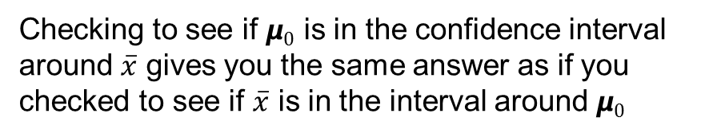
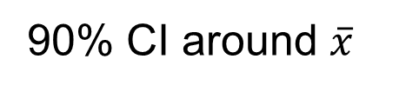
90% interval around 𝞵₀
0.05
0.05
90% CI around $\overline{x}$
0.05
0.05
Checking to see if 𝞵₀ is in the confidence interval around $\overline{x}$ gives you the same answer as if you checked to see if $\overline{x}$ is in the interval around 𝞵₀

Slide 15
Use of P-Values in Hypothesis Testing
P-value
probability associated with the test statistic.
smallest level of α risk that would lead to rejection of the null hypothesis H₀
probability of getting a value further out than your test values
No voice

Slide 16
Hypothesis Tests
Single sample Mean, large sample size - Z test
Single sample mean, small sample size – t test
2 sample means, large sample sizes – Z
2 means, small sample sizes, variance equal – t
2 means, small sample sizes, variance unequal – t
Paired comparison – t
2 variances – F
Single sample proportion, Z test
2 proportions - Z
Proportions – chi squared test
Contingency Tables – chi squared test

Slide 17
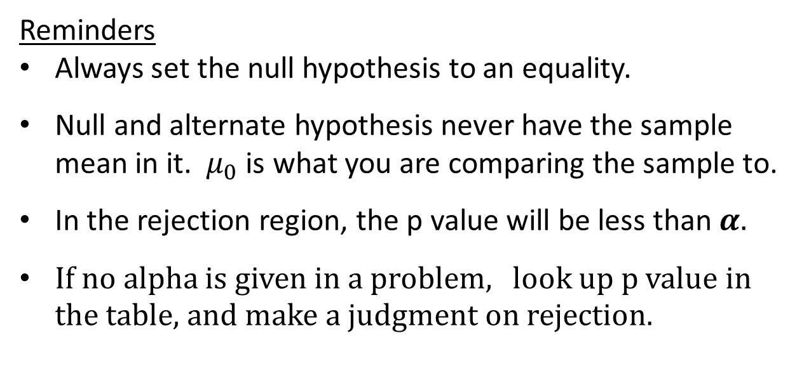
Reminders
Always set the null hypothesis to an equality.
Null and alternate hypothesis never have the sample mean in it. $μ_{0}$ is what you are comparing the sample to.
In the rejection region, the p value will be less than 𝜶.
If no alpha is given in a problem, look up p value in the table, and make a judgment on rejection.

Slide 18
Reminders –
The assumption with the Z test is that 𝞼 is known or can be reasonably estimated with the sample data.
Use the t test with sample sizes less than 30. 𝞼 is considered unknown and not estimated accurately with s.

Slide 19
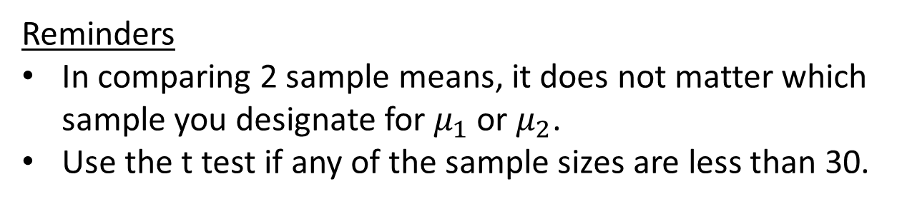
Reminders
In comparing 2 sample means, it does not matter which sample you designate for $μ_{1}$ or $μ_{2}$.
Use the t test if any of the sample sizes are less than 30.
No voice

Slide 20
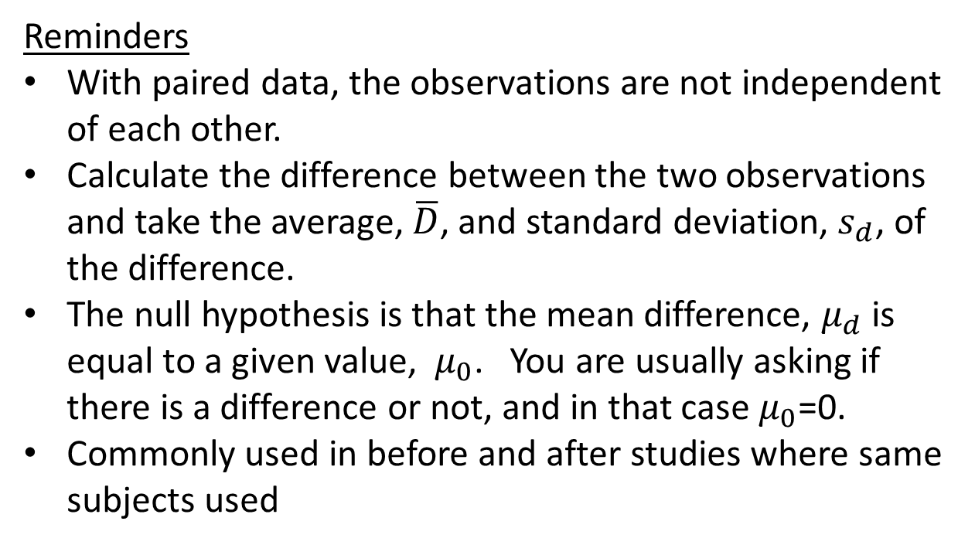
Reminders
With paired data, the observations are not independent of each other.
Calculate the difference between the two observations and take the average, $\overline{D}$, and standard deviation, $s_{d}$, of the difference.
The null hypothesis is that the mean difference, $μ_{d}$ is equal to a given value, $μ_{0}$. You are usually asking if there is a difference or not, and in that case $μ_{0}$=0.
Commonly used in before and after studies where same subjects used

Slide 21
Reminders
F test is always set up with the larger variance on top, so even if it is a ≠ alternate hypothesis, only the greater than side is checked.
In the F table, the numerator degrees of freedom is across the top of the table, and the denominator degrees of freedom is on the side..

Slide 22
Reminders
Z test is used for normal approximation of binomial when p is large and n is large (np>5 and n(1-p)>5).
The word percent is often used when referring to a proportion.

Slide 23
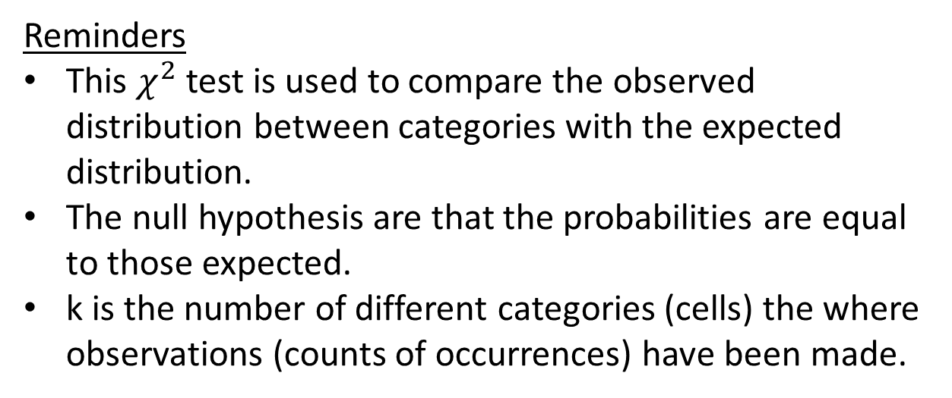
Reminders
This $χ^{2}$ test is used to compare the observed distribution between categories with the expected distribution.
The null hypothesis are that the probabilities are equal to those expected.
k is the number of different categories (cells) the where observations (counts of occurrences) have been made.

Slide 24
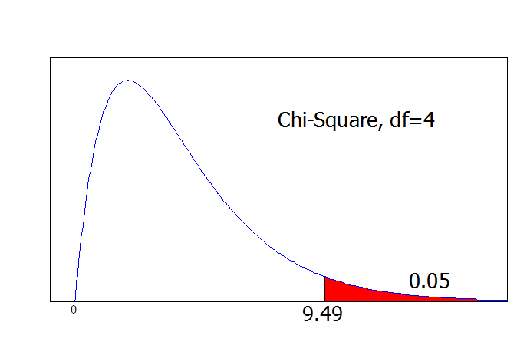
9.49
Critical Region
Rejection Region
X ²_{α}
Rejection region: X ² > X ²_{α}
with (k-1) degrees of freedom,
where k is number of cells

Slide 25
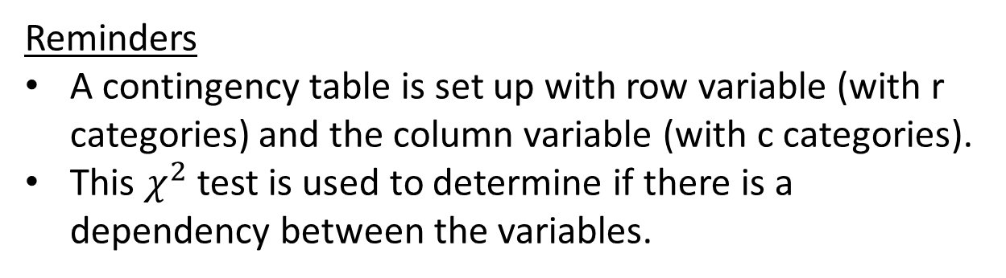
Reminders
A contingency table is set up with row variable (with r categories) and the column variable (with c categories).
This $χ^{2}$ test is used to determine if there is a dependency between the variables.

Slide 26
Contingency Tables
Hypothesis:
Ho: The two variables are independent
Ha: The two variables are dependent
Reject region: X ² > X ²_{α} with (r-1)(c-1) degrees of freedom
Test stat:
where
and Oij = observed value
Sample set-up for 2x2
type 1
type 2
Totals
Category 1
O₁₁
O₁₂
R1
E₁₁
E₁₂
Category 2
O₂₁
O₂₂
R2
E₂₁
E₂₂
Total
C1
C2
N

Slide 27
Type I Error
α - Probability of saying a process changed when it did not
α/2
α/2
μ₀

Slide 28
Type II Error
β - Probability of saying a process did not change when it did.
1-β = Power
Ability to detect change
α/2
α/2
μ₀
Reject null
Do not reject null
Reject null

Slide 29
Computing the Power
Compute the rejection region.
Set up a confidence interval for given sample size and Type I risk.
Compute the probability that the test statistic falls in the rejection region for a given difference from the null. This is power.
Power can be improved by increasing the sample size or increasing alpha.

Slide 30
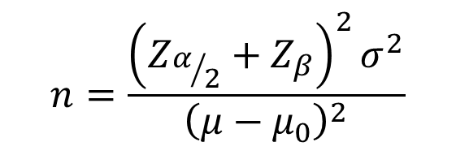
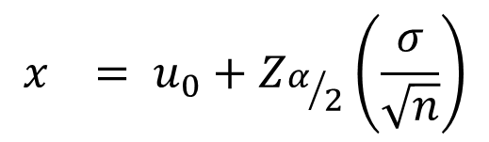
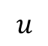
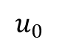
Determining Sample Size with specified 𝜶 and 𝜷
𝜷
$$u_{0}$$
x
$$u$$
For the hypothesis test
the upper limit critical point is
For the shifted distribution, the x value associated with 𝜷 in the tail is
$$x_{}=u−Z_{β}\left(σ/{\sqrt{n}}\right)$$
$$x_{}= u_{0}+Z_{α/2}\left(\frac{σ}{\sqrt{n}}\right)$$
$$n=\frac{{\left(Z_{α/2}+Z_{β}\right)}^{2}σ^{2}}{{\left(μ−μ_{0}\right)}^{2}}$$
Setting the two equations equal to
each other, then solving for n:

Slide 31
End of Hypothesis Testing Review

